Slide 1
Tp Java Project{
index.html
info.css
[Student & course Management system]
< Ramla Azouni LCE-IOT 2 >
}
TP JAVA

Slide 2
ReadMe.md;
index.html
info.css
A Java project that creates a Management System for a school with UI. You can :
create a new student,
create a new course,
add students in the course
see the details of that course
Programming Language

Slide 3
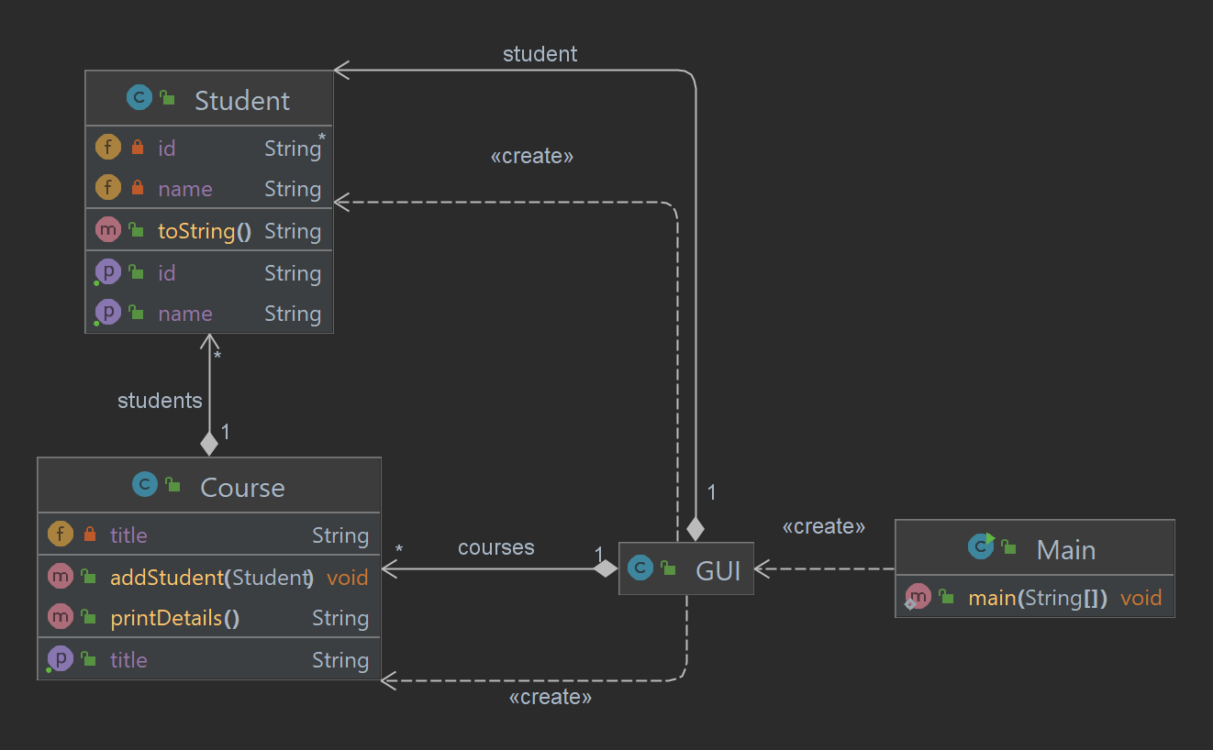
Class Diagram

Slide 4
Java Classes in The Project {
01
02
03
04
index.html
info.css
Student Class
< You can enter the Student’s name and ID >
Course Class
< You can add the student and check if they’re enrolled in the course of not >
Main Class
< It Creates a new instance of a class called "GUI" and runs it>
GUI Class
}
< Where There’s the implementation of The UI Using AWT >

Slide 5
01 {
[Student class]
index.html
info.css
< You can enter the Student’s name and ID >
}

Slide 6
02 {
[Course class]
index.html
info.css
< You can add the student and check if they’re enrolled in the course of not >
}

Slide 7
03 {
[Main class]
index.html
info.css
< It Creates a new instance of a class called "GUI" and runs it>
}

Slide 8
04 {
[GUI class]
index.html
info.css
< Where There’s the implementation of The UI Using AWT >
}

Slide 9
[GUI class]: Implemented AWT(Abstract Window Toolkit) Packages
Package : a Set Of Classes
Reference : AWT Documentation // https://docs.oracle.com/javase/7/docs/api/java/awt/package-summary.html //
index.html
info.css

Slide 10
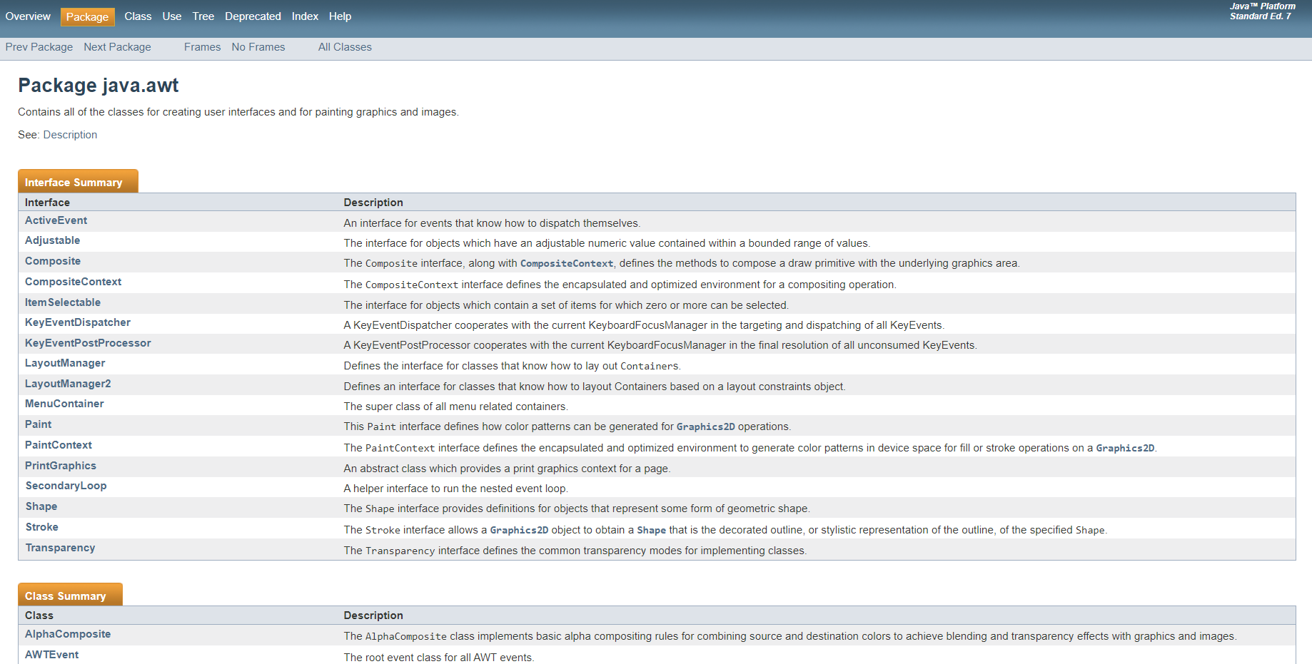
index.html
info.css

Slide 11
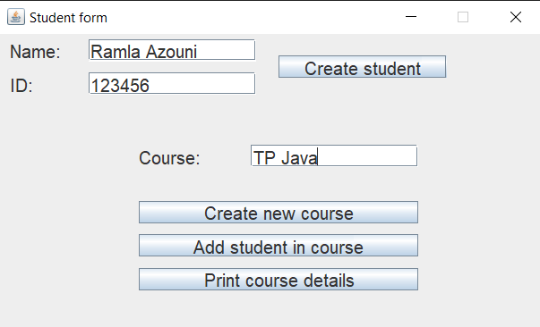
GUI Preview:
index.html
info.css

Slide 12
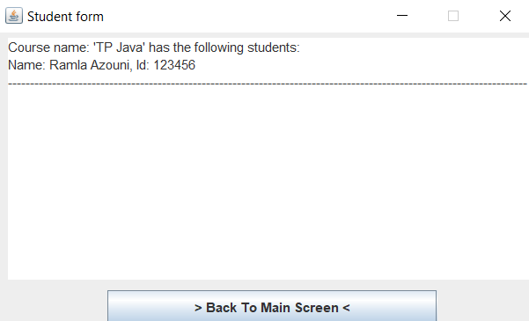
GUI Preview:
index.html
info.css

Slide 13
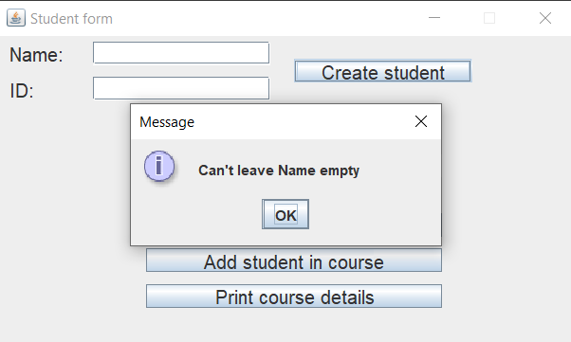
GUI Preview:
index.html
info.css

Slide 14
Thank{ YOU;
index.html
info.css
}

